Slide 1
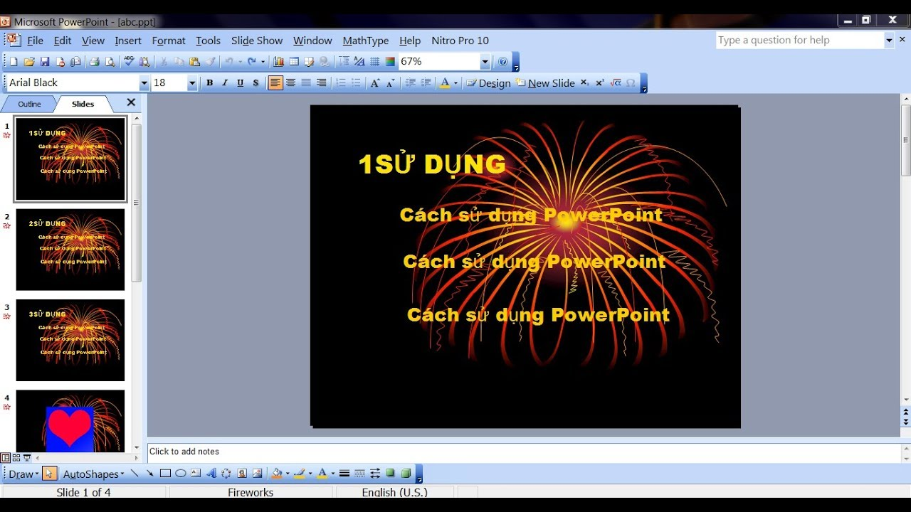
Powerpoint Office 2003

Slide 2
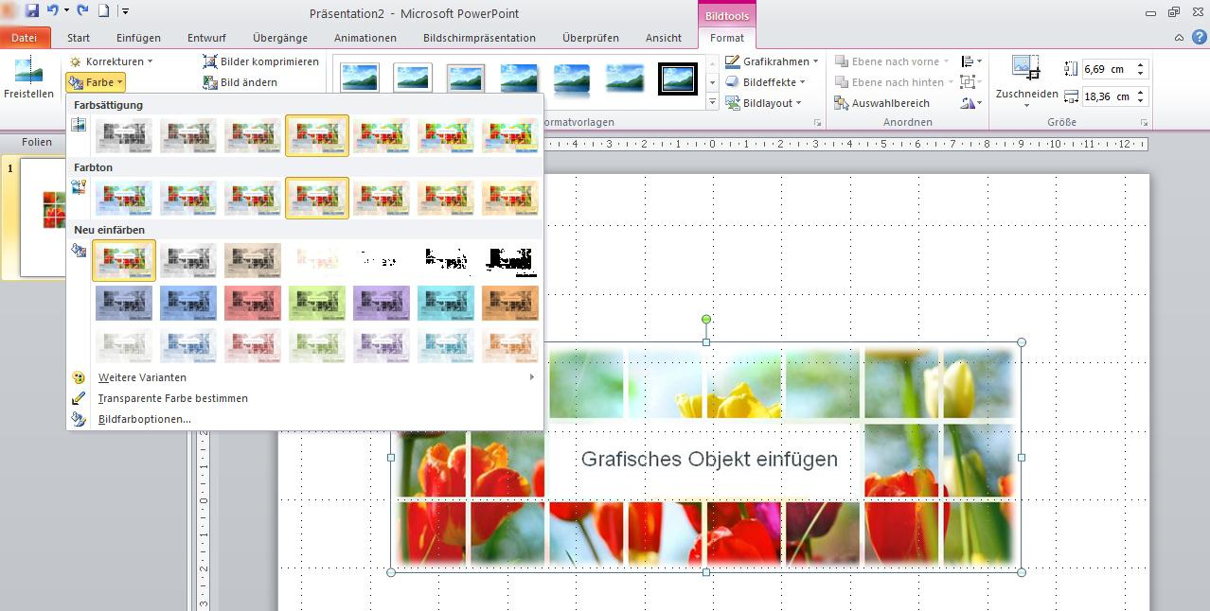
Powerpoint Office 2010

Slide 3
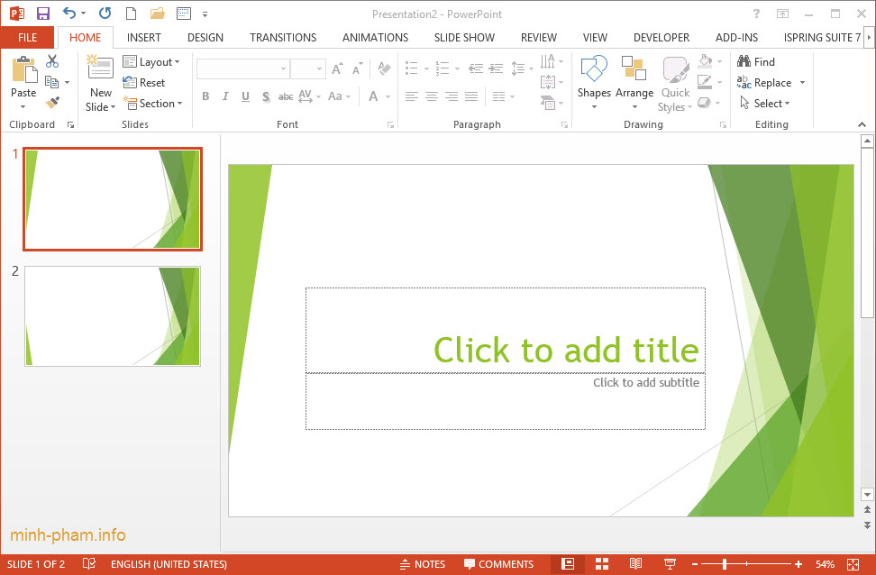
Powerpoint Office 2013

Slide 4
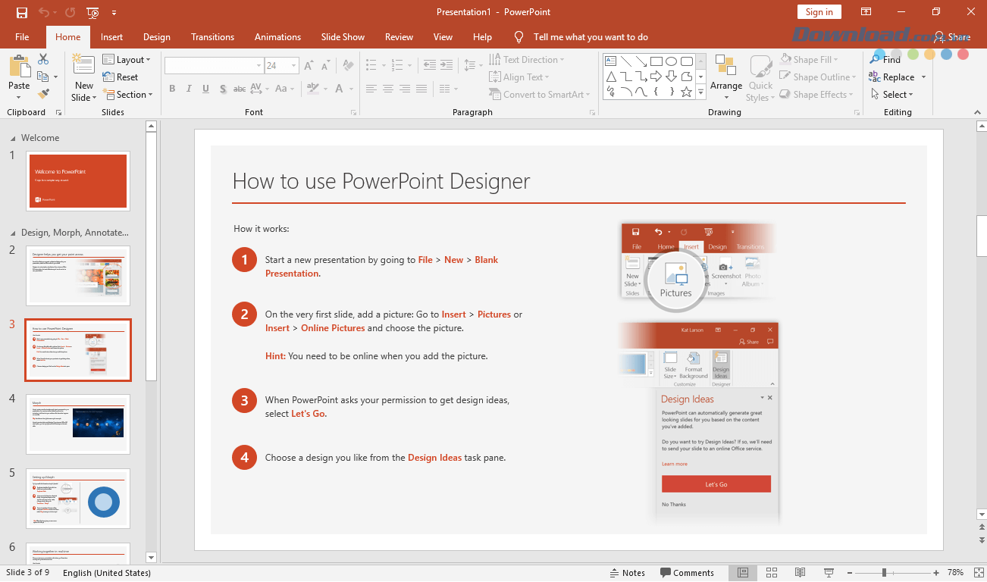
Powerpoint Office 2016/2019

Slide 5
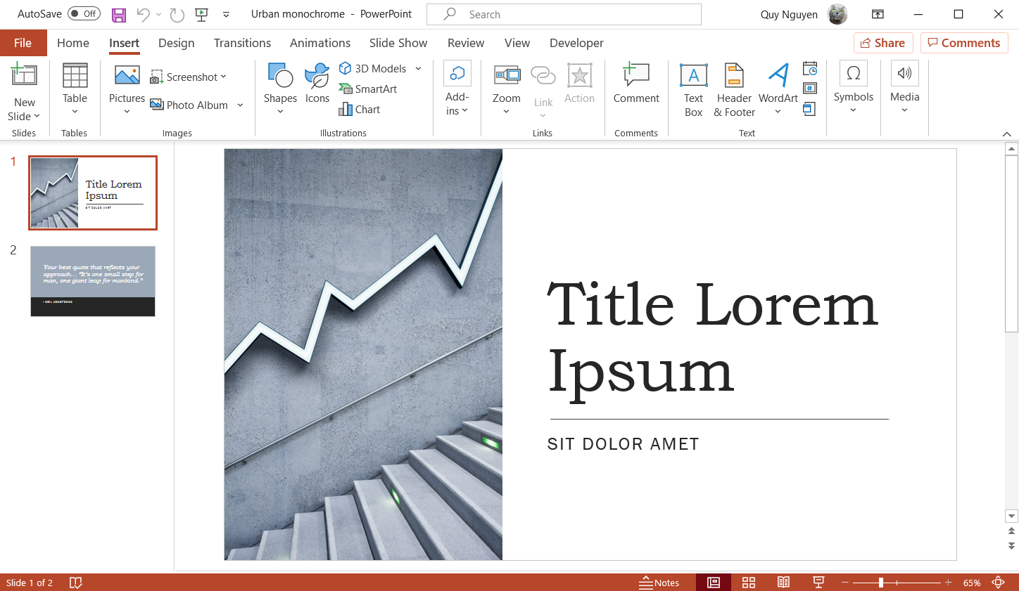
Powerpoint Office 365

